Slide 1
Hardening CrackMe Binaries Against Reverse Engineering
By: Bryce, Sami, and Maryam

Slide 2
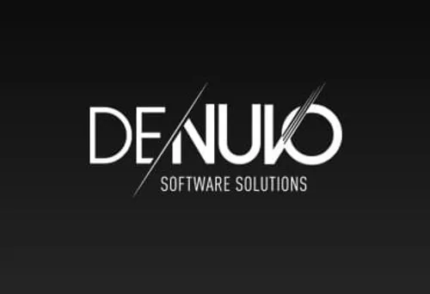
What our project is about

Slide 3
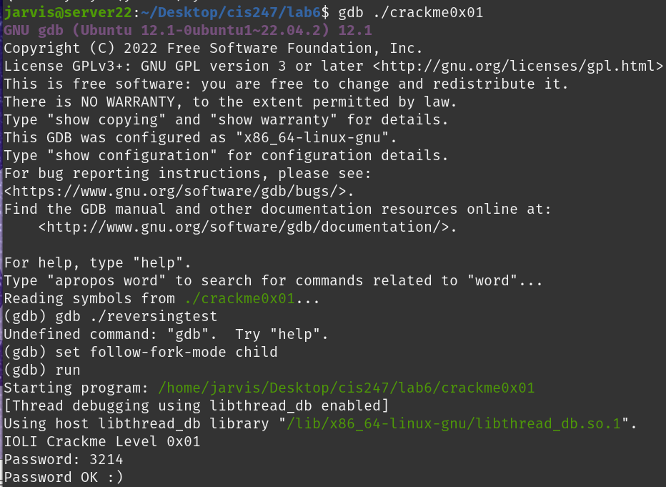
Initial state of Crackme0x01 -Bryce

Slide 4
Key concept
There can only be one active debugger at a time

Slide 5
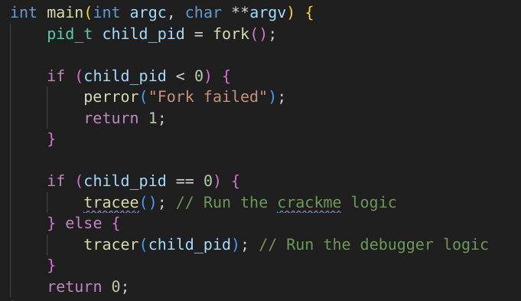
Phase 1: The Fork
Program calls fork to create a parent and child process
  Child (tracee): runs actual program logic (password check)
  Parent (tracer): runs self debugging logic and modifies the child code through fixing correcting syscall
Purpose: a process cannot debug itself, but a parent process can.

Slide 6
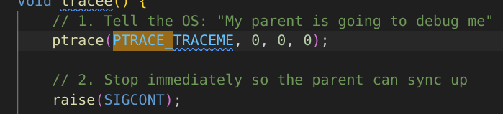
Phase 2: The child
The child must first allow the parent to trace it by calling the command “ptrace(PTRACE_TRACEME)”
The child then waits for the parent to sync up so there is not a race condition

Slide 7
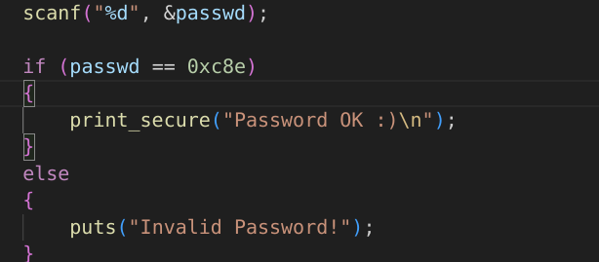
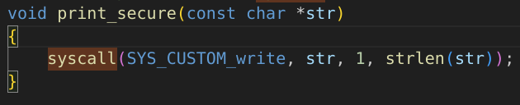
Next the child process runs the sensitive code (if passwd == 0xc8e)).
If correct we call syscall 10000 which is an invalid syscall
  This pauses the process where under normal circumstances the OS would pause process.

Slide 8
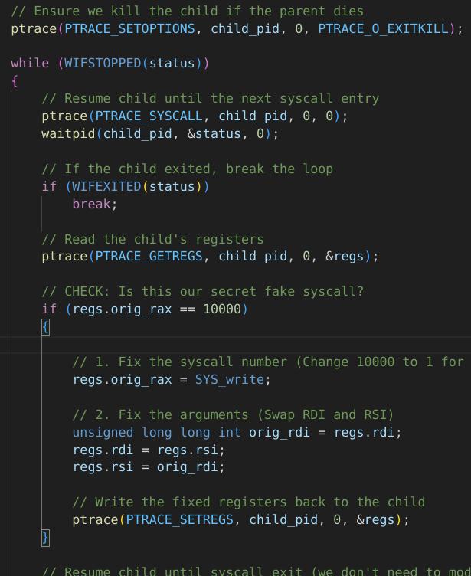
Phase 3: The parent
Because of the one debugger rule, this parent process can only run if it is not in a debugger.
The parent process waits for the OS to notify it that the child has paused
  Waitpid(child_pid, &status, 0);
It reads the CPU registers and checks for the invalid syscall
  If regs.orig_rax == 1000
If this thread is not in a debugger then the parent thread will fix the syscall error by changing the syscall 10000 to a syscall 1
  This is that makes the code self modifying

Slide 9
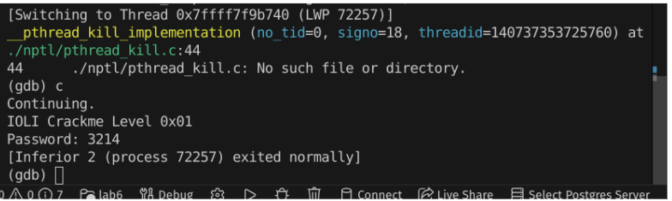
Trying to crack in GDB
We can verify by opening in GDB and trying to debug the file.
Because GDB occupies the single debugger slot when we put the correct password in.
The process fails silently and “Password OK” is not printed.

Slide 10
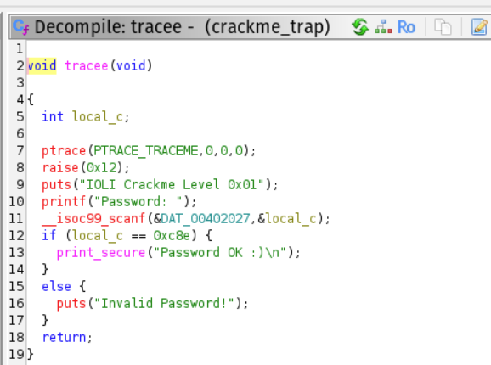
The bypass
Because this trick only effects dynamic analysis (such as GDB). static analysis like strings or Ghidra is not affected.
Therefore we can see the full code in Ghidra.

Slide 11
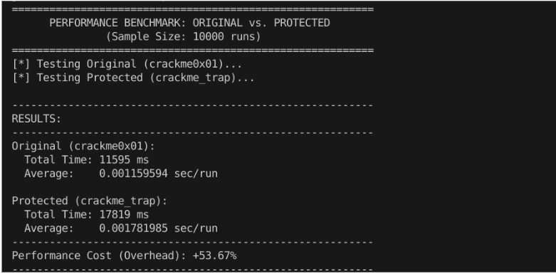
Performance Impact
There is a performance cost from calling ptrace(PTRACE_SYSCALL) to monitor the child
  This tells the OS to pause the child every single call
We observed at least a 50% performance cost for this code
This performance cost is observed in some games which use DRM (obfuscation)

Slide 12
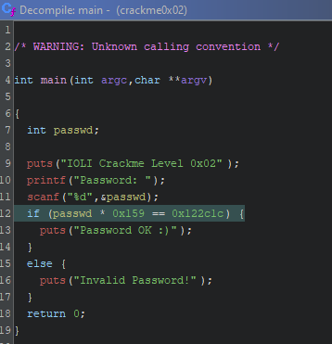
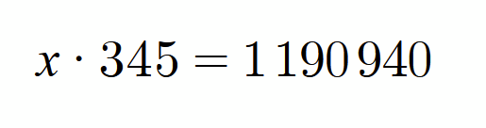
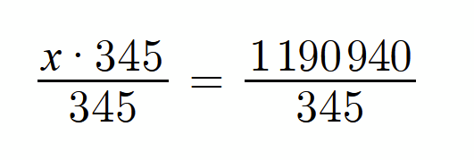
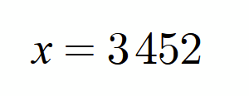
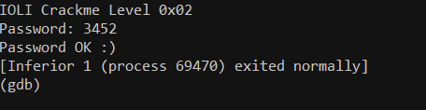
Sami - Crackme0x02
Logic Summary:
Prints intro + prompts for password
Reads integer input
Computes: passwd * 0x159
Compares result to 0x122c1c
If equal → “Password OK :)”
Else → “Invalid Password!”

Slide 13
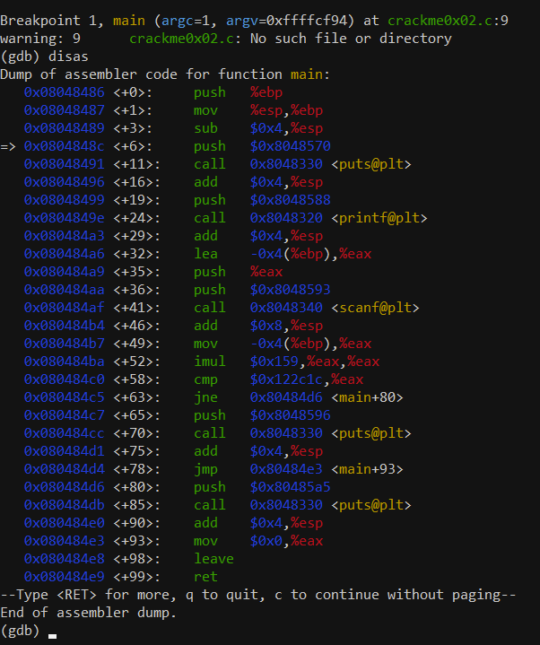
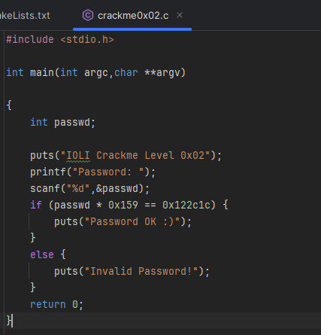
Why This Is Insecure
Math constants plainly visible
Straight-line logic
No decoys
No anti-debugging
No compiler hardening flags

Slide 14


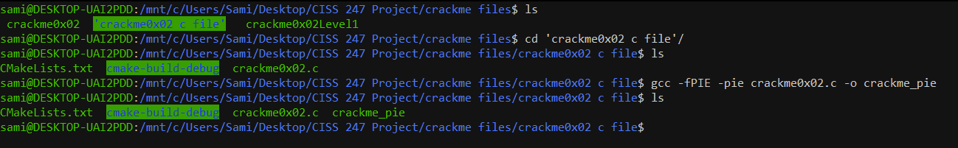
Level 1 Hardening (Compiler-Level)
Techniques Applied:
Symbol stripping (via strip command)
  strip crackme0x02
Position Independent Executable (PIE)
  gcc -fPIE -pie [target-file.c] -o [output-file]
Stack Protector
  gcc -fstack-protector-all -fPIE -pie [target-file.c] -o [output-file]

Slide 15
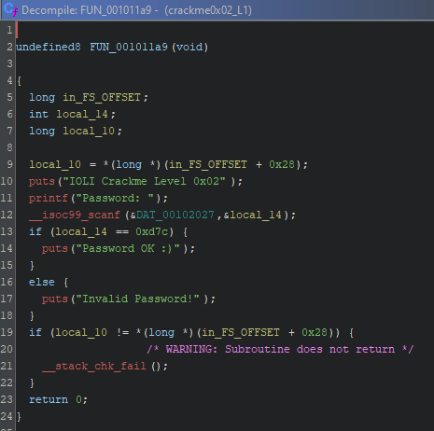
Impact of Level 1 Hardening
Difficulty rating - Low/Medium:
Debugging is less convenient
Ghidra reconstruction slightly noisier
But overall logic still trivial to recover

Slide 16
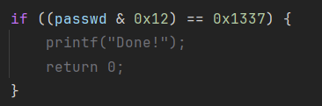

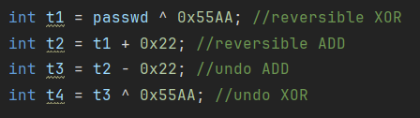
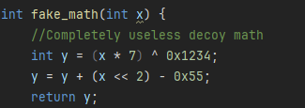

Level 2 Hardening (Code Obfuscation)
Techniques Applied:
Decoy comparisons
  Reverser must trace dataflow
Fake success branches
  Can't rely on first “correct” branch
Misleading password logic
  Password no longer readable by scanning constants
(void)junk
  Prevents the compiler from removing unused variables.

Slide 17
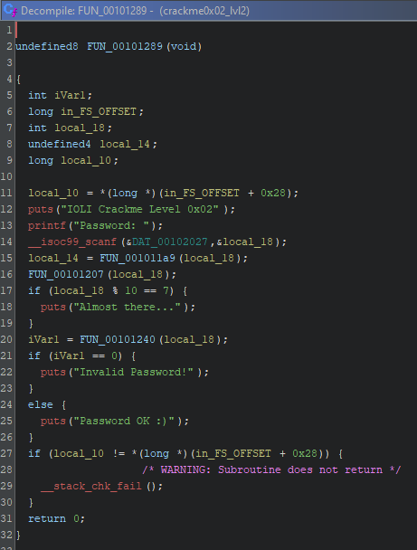
Impact of Level 2 Hardening
Difficulty rating - Medium:
Requires more experience
Requires stepping through branches
Obscures the “obvious math solution”
Still breakable, but much slower compared to Level 1.

Slide 18

Maryam - Crackme0x03
The goal of my part of the project was
Understand the original CrackMe 0x03 behavior
Reverse engineer it with Ghidra
Find all the weaknesses
Rewrite it myself in C
Then start hardening it
My main goal was to hide the password and hide the messages so they do not show up anywhere in the binary.

Slide 19
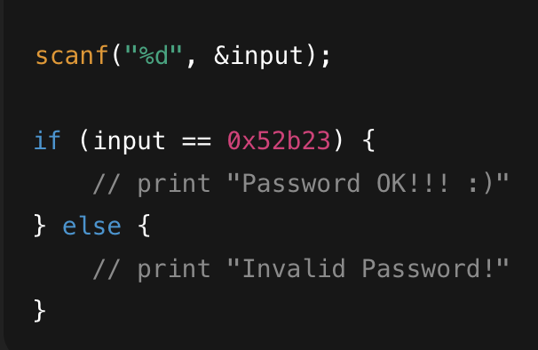
Baseline Behavior (Original Program)
Here is what the original CrackMe does
• Prints a banner
• Asks for an integer password
• Compares the password directly to the constant 0x52b23
• If it matches it prints “Password OK!!! :)”
• If it doesn’t it prints “Invalid Password”
• Everything is extremely easy to see
In Ghidra the original main function literally shows
if (password == 0x52b23)

Slide 20
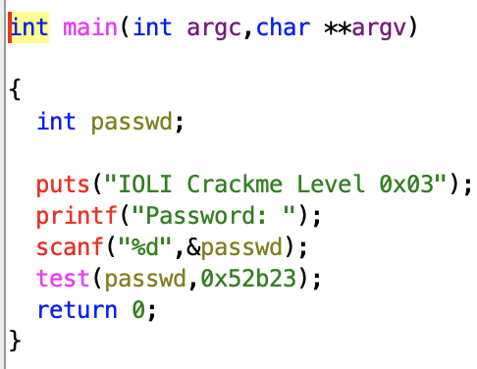
Why the Original Is Insecure
Why the baseline CrackMe is insecure
• The OK and FAIL messages appear as normal strings
• The password constant 0x52b23 is directly visible
• Nothing is encoded or hidden
• The program flow is super obvious
• Anyone can reverse it in under a minute
This means a beginner can solve it just by opening it in Ghidra and looking at the decompiled main function.

Slide 21
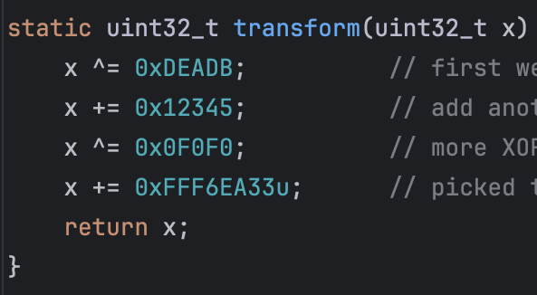
Hardening Approach Overview
My plan to harden the program was
• Remove every readable message
• Encode the success and fail messages with XOR
• Decode them only when needed
• Hide the password check behind a transform function
• Use volatile so compiler doesn’t undo my encoding
• Keep some old functions as extra noise
This way the binary looks more confusing and the answer is not just sitting there.

Slide 22
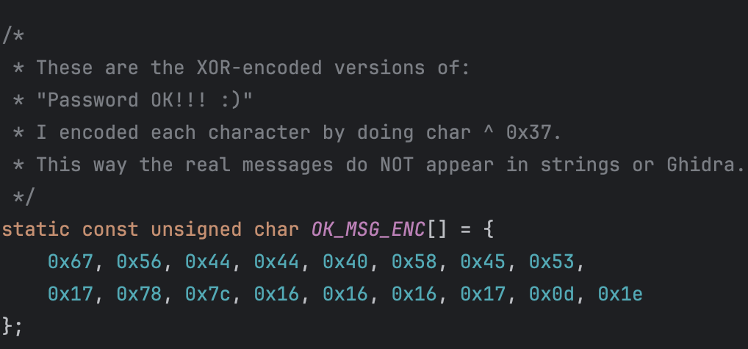
Technique 1: XOR String Obfuscation
First technique I used: XOR encoding the strings
• Instead of storing the messages in plaintext
• I encoded every character as char ^ 0x37
• The real messages no longer appear in the compiled binary
• If someone runs the strings command they see nothing useful
This removes the easiest way to reverse the program.

Slide 23
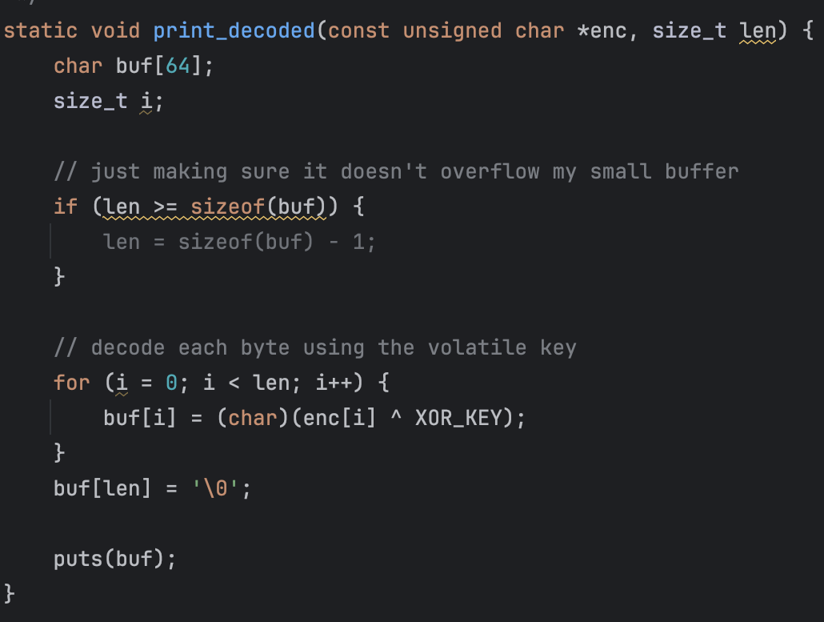
Technique 2: Runtime Decode Function
Second technique: decoding the strings at runtime
• I wrote a print_decoded() function
• It takes the encoded bytes and XORs them back
• The real text only exists in RAM for a moment
• Ghidra shows a weird XOR loop instead of readable output
This forces a reverser to understand my decoding logic.

Slide 24
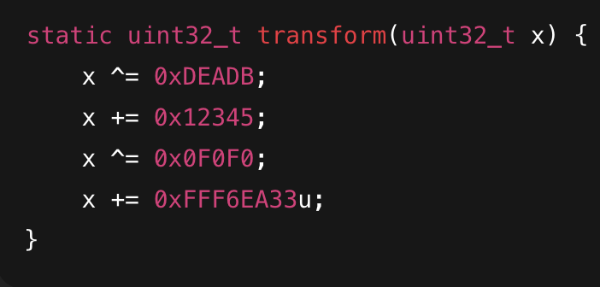
Technique 3: Password Transform Obfuscation
Third technique: hiding the password behind math
• Instead of checking if input equals 0x52b23
• I made a transform() function
• It runs the input through XORs and additions
• Only the real password makes transform(input) return 0
• The real password value is never written in the code
This makes the logic harder to follow in Ghidra.

Slide 25
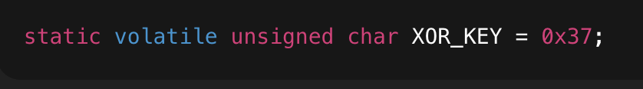
Technique 4: Using volatile to Prevent Optimization
Fourth technique: the volatile keyword
• I made the XOR key volatile so GCC can’t optimize it
• Without volatile the compiler might pre decode the strings
• Volatile forces the XOR to happen only at runtime
• This helps keep my messages hidden in the binary
It’s a small trick but it matters for obfuscation.

Slide 26
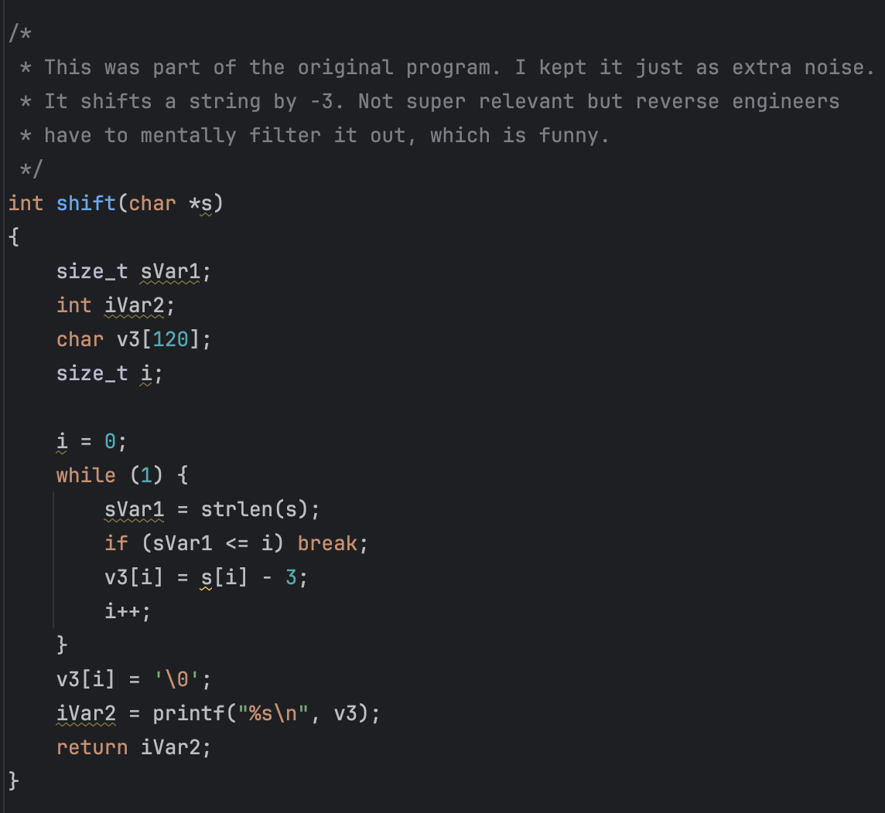
Technique 5: Adding Noise Code
Fifth technique: noise in the code
• I kept the original shift() function
• It is not used anywhere
• It just exists to confuse the decompiled output
• Reverse engineers have to waste time checking if it matters
This helps make the program look more complex.

Slide 27
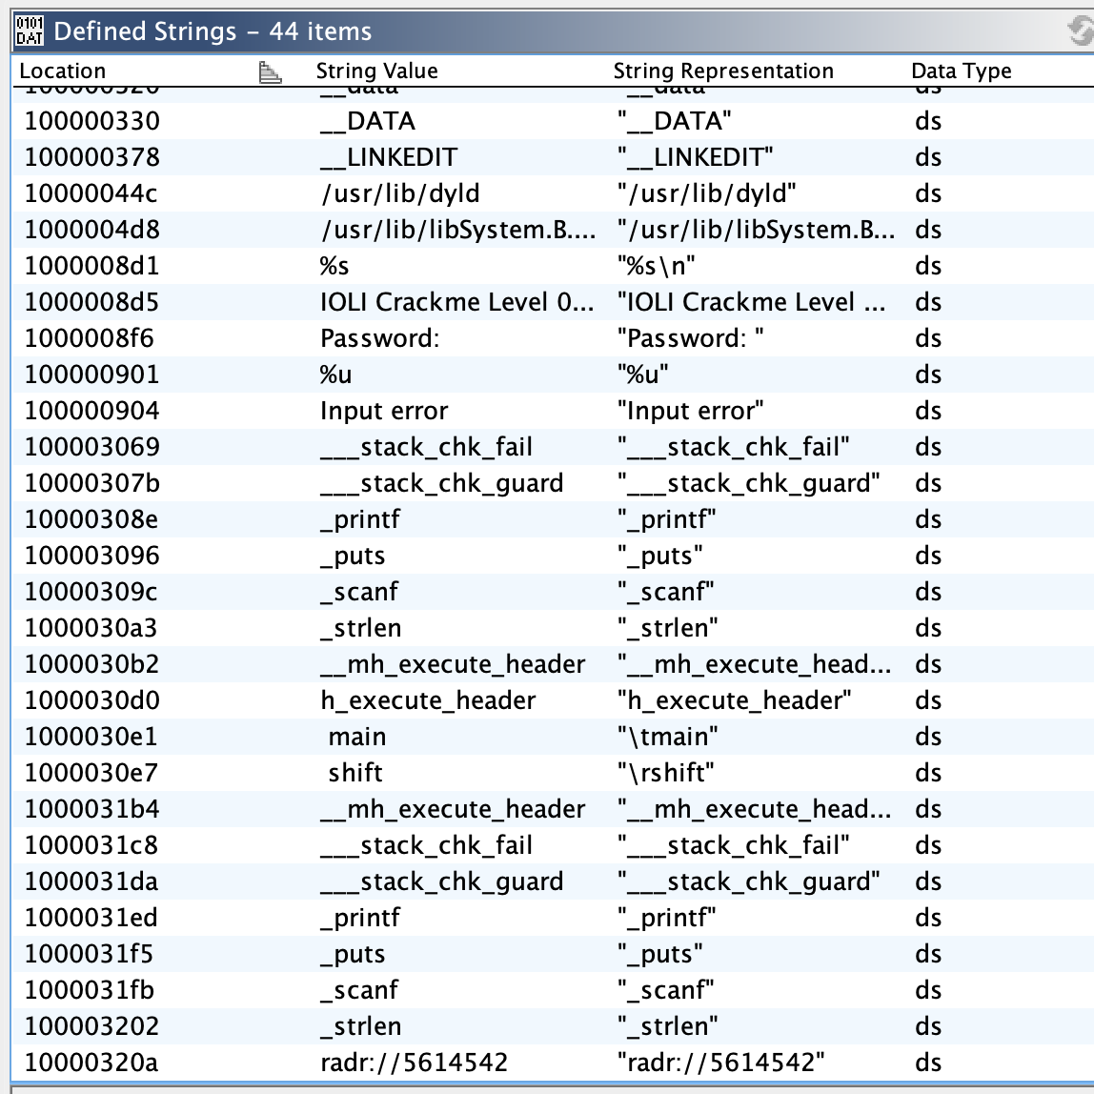
Results: Strings Are Hidden
After hardening
• The OK and FAIL messages do not show up in strings
• The Defined Strings window in Ghidra does not show them either
• Only the banner and input prompt are visible
• This proves the obfuscation on the messages worked
This is one of the biggest improvements over the original.

Slide 28
Results: Strings Are Hidden
After hardening
• The OK and FAIL messages do not show up in strings
• The Defined Strings window in Ghidra does not show them either
• Only the banner and input prompt are visible
• This proves the obfuscation on the messages worked
This is one of the biggest improvements over the original.

Slide 29
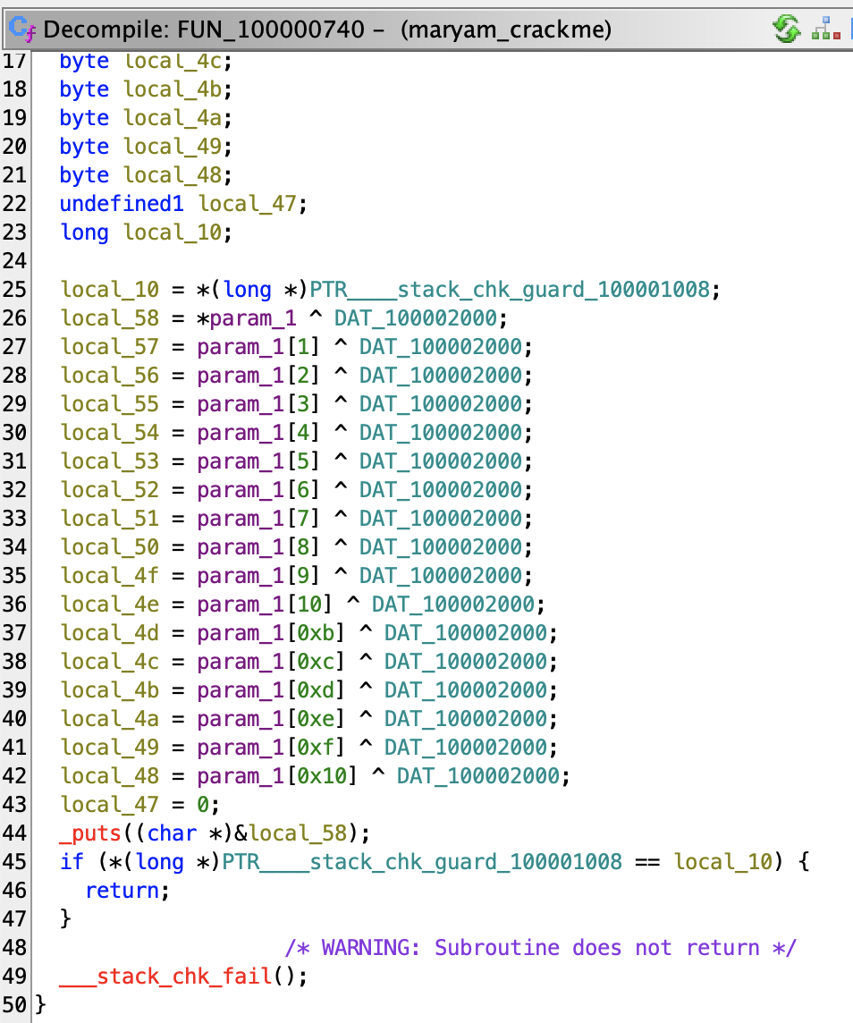
Results: Decode Function in Ghidra
What Ghidra sees now
• Instead of showing readable output text
• It shows a long XOR loop
• The decode function is messy and packed with operations
• A reverser needs to manually track what the encoded bytes become
This makes reversing slower and more annoying.

Slide 30
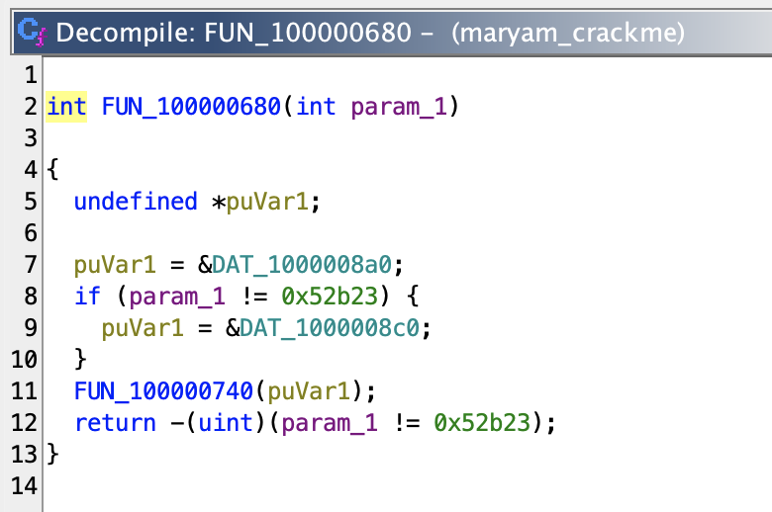
Current Issue I'm Still Working On
What Ghidra sees now
• Instead of showing readable output text
• It shows a long XOR loop
• The decode function is messy and packed with operations
• A reverser needs to manually track what the encoded bytes become
This makes reversing slower and more annoying.

Slide 31
Overall Difficulty Rating
After hardening my CrackMe
• It is definitely harder than the original
• Strings are hidden
• Logic is disguised
• Password is meant to be obfuscated
• Noise code adds confusion
• I would rate the difficulty as medium for a beginner reverser
This is a big improvement over the baseline.

Slide 32

Conclusion
In this project we learned
• How easy it is to reverse a normal binary
• How to use Ghidra to inspect code
• How to remove obvious vulnerabilities
• How to encode and decode strings
• How to hide logic behind transformations
• And how much work it takes to harden even a small program

